Slide 1

Movie Box Office Revenue Prediction

Slide 2
Team-13
Harshitha
Madhav
Bhargavi
Saiganesh
-Team Leader
Model deployment
Data collection
Data evaluation
Data visualization
Model development

Slide 3
The Problem
“The first issue is that 50% of the time, movies have the opposite outcome; why does this happen? due to the model's structural components? or flawed data?”
01
“In this project another most common problem is underfitting and overfitting.?”,
02

Slide 4
The Solution
Solution #1 Building Better Models with high Accuracy Training
Data high-accuracy
Solution #2 Using More features according to problem
Solution #3 Using Hyperparameters to improve prediction accuracy.
01
02
03

Slide 5
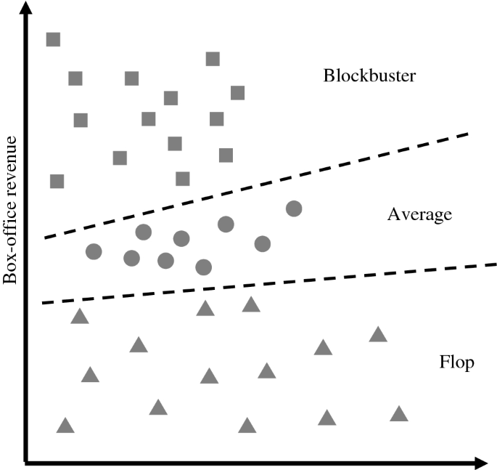
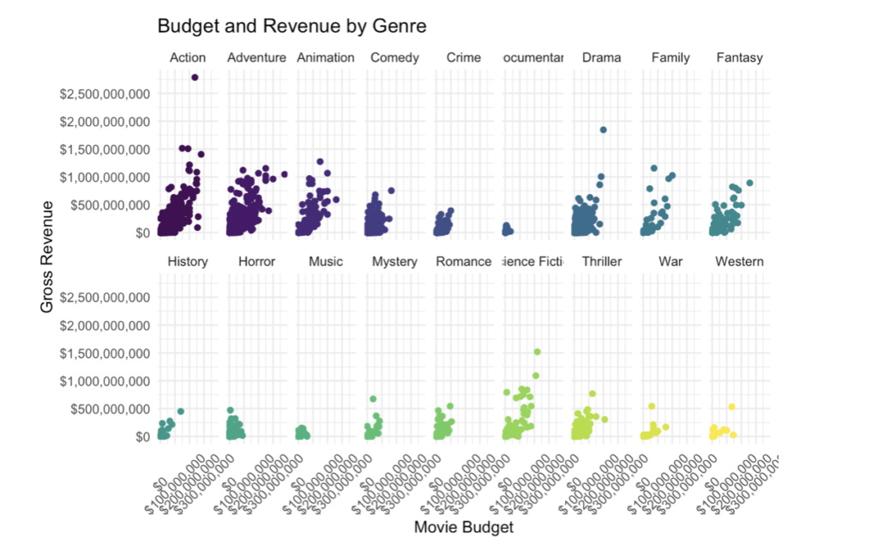
Prediction Output

Slide 6
Business model / Plan
1
DATA Collection
2
6
Data Verification
Train and test / Deployment
Our Plan
3
5
Models Analysis
Model Creation
4
Feature Engineering

Slide 7
Technology/expertise
Algorithms 1. Random forest
2. Linear Regression
3.Polynomial Regression
Techniques for creating models that are engaged in the key three processes
One of the main jobs is dividing the test and train data, as well as Feature Engineering and Dimensionality reduction.
Data-set We collected the data from Kaggle and referenced various local websites because data sets play an intriguing function in this research.

Slide 8
Why We are Better?
Data Quality
Interpretability
Accuracy
Our model is more accurate in predicting box office revenues compared to alternative models, means it provides more reliable estimates.
If we have access to high-quality, comprehensive data that others don't, it can lead to better predictions.
Some models might be better at explaining the factors that influence box office revenue, making them more suitable for decision-making in the film industry.

Slide 9
Measuring Success
The metrics that matter
How will we define & measure success?
Cross-Validation
Real-world Testing
Benchmarking
Use techniques like k-fold cross-validation to assess the model's ability to generalize to new data and ensure that it's not overfitting.
If possible, apply the model to real movie releases and analyze its performance. This can provide valuable insights into its practical success.
Compare your model's performance against existing models or historical data to determine if it outperforms or meets predefined success criteria.

Slide 10
Roadmap, metrics milestones
Milestone #1
Training the model on historical data, this marks the first time the model making prediction.
Milestone #2
Creating and selecting the right features that improve the model predicting power.
Milestone #3
Deploying the model in a productive environment, ensuring it can provide real-time prediction as needed.

Slide 11
THANK YOU

